Slide 1
“I see, I remember, I do, I understand.” Narratives of Empathic and Non- Empathic Experiences in Everyday Life
Rachel Plowman
Supervisor: Dr. Kendall Soucie
Notes:
- “Why do we hurt others?”
- Investigates the motivational aspects of helping and harming others
- Archival data

Slide 2
What is Empathy?
Empathy is the ability and/or inclination to understand and vicariously experience another’s emotional state or condition.
(Eisenberg, Spinrad & Sadovsky, 2006)
Notes:
- Emotional response on behalf of another person,
- Understanding

Slide 3
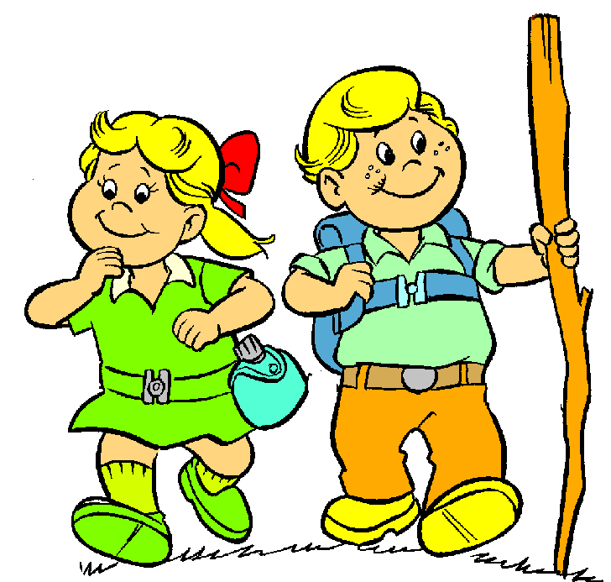
Problems with Measuring Empathy
Traditionally measured with experimental study approach
Picture-Story Method – priming subject
Questionnaires with Likert Scale
E.g., “I sometimes find it difficult to see things from the "other guy's" point of view.
Quantitative is unrealistic!
Vulnerable experience can’t be quantified
Necessary to look deeper
Qualitative is a better option!
An adventure of exploration!
Notes:
How can you quantify a vulnerable experience?
- qualitative is a better option to encompass an emotional experience in a narrative rather than a number

Slide 4
Previous Research & The Life Story Model
Dr. Dan McAdams
Northwestern University
Dr. Monisha Pasupathi
University of Utah
Dr. Holly Recchia
Concordia University
Notes:
Dan – Life Story Model – centres around the fact that peoples’ identity is formed from experiences and we need these experiences for personal and moral development.
Holly & Monisha
- help/harm & consequences, prosocial identity,
- recent studies – few look at empathy with qualitative approach

Slide 5
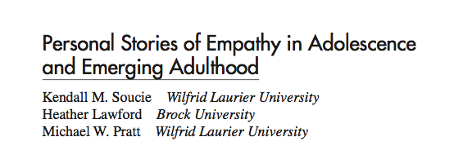
How did the idea emerge?
(Soucie, Lawford, & Pratt, 2012)
Notes:
- Participants: Age 14-18
- 65 Stories
- Empathy, non-empathy,
- “Tell me a time when you felt sad for someone?
-Tell me a time when you didn’t feel sad for someone and felt you should have?”

Slide 6
Empathic Story (Soucie, et al., 2012)
“I went to Jamaica, on a… self-help mission… some days my teacher just wouldn’t show up [at] school, so I had to take over the entire class … some of the students that were at the back of the classroom, they weren’t the smartest ones … they don’t get really any academic attention … I felt sad the fact that, you know, even though these kids might want to get to the front because they … keep getting pushed farther and farther back, they’ll never get up there, so.”
(Participant #7, Male, 18 years of age)
* Narrative has been edited for length*
(Soucie, et al., 2012)
Notes:
What do you see in this story?
People deserved his empathy
People know they’re doing the right thing
Looking to reaffirm they’re a good person

Slide 7
Non-Empathic Story (Soucie, et al., 2012)
“…I guess a month after I got back from Jamaica, … six guys from my gradating class got expelled … for hazing grade nine students … the hazing wasn’t even that bad… I just didn’t like the kids that were getting expelled … they made this school announcement and some people were crying … like me and some of my friends were just so happy because some of these kids were so cocky …annoying and they were so arrogant and into themselves... They were terrible people, I did not like them. They both treated me like crap in South Africa, they stole from me … I guess at the time when everybody else was in a sense feeling sad for them, I just was happy they were gone.”
(Participant #7, Male, 18 years of age)
* Narrative has been edited for length*
(Soucie, et al., 2012)
Notes:
What do you see in this story?
justification for why they can feel this way

Slide 8
Predominant Theme
Relationship
Mortality
Achievement
Leisure
(Soucie, et al., 2012)
Notes:
- Sad – mortality highest
- Non-sad – relationship highest
- no leisure narratives

Slide 9
Tension
Present
Absent
(Soucie, et al., 2012)
Notes:
- more tension present in non-sad stories
- suggests people may put aside differences to feel empathic

Slide 10
Relationship
Parent/Sibling
Friend/Relative
Acquaintance
*Qualitative code created by Rachel Plowman
Notes:
- friend/relative is most frequent relationship category
- no instances of romantic relationships
- could be because the sample was relatively young – value friendships more

Slide 11
Perspective
None
Non-Parallel
Parallel
(Soucie, et al., 2012)
Notes:
- sad stories – more non-parallel
- non-sad – more instances of no perspective-taking

Slide 12
Blame
None
Moderate
Significant
*Qualitative code created by Rachel Plowman
Notes:
- Almost no blame in sad stories
- Non-sad – greater instance of blame – specifically moderate level of blame

Slide 13
Self-Event Connection
None
Stability
Illustrative
Explanatory
Change
Causal
Reveal
(Pasupathi & Weeks, 2011)
Notes:
- Less self-event connections within non-sad stories – younger sample possibly less able to retrospectively examine the experience
- illustrative – most common connection overall
- non-sad events don’t often cause changes – possibly less meaning?

Slide 14
Hypotheses – Re-evaluated!
Empathic stories
Increased relationship, mortality, & tension themes
Less blame
More change engendering self-event connections
Increased parallel perspective-taking
Increased closeness* to protagonist
Notes:
Grounded theory – emerging from data
REC Approval – able to look at data for themes

Slide 15
Hypotheses – Re-evaluated!
Non-Empathic stories
Increased achievement, leisure & few tension events
Increased blame
Increased stability maintaining self-event connections
Decreased ability to take perspective of protagonist
Decreased closeness* to protagonist

Slide 16
Preliminary Themes: Non Empathic Stories
No Empathy
Lack Closeness
Blame
Justification
Notes:
- Wall theory – opening themselves up – less vulnerable

Slide 17
Preliminary Themes
Sad Stories
Less variation – huge focus on mortality incidents of people removed from the protagonist
Age-Related Findings
Younger participants less likely to take the perspective of individual, or develop self-event connection
Less life experience or reflective thinking at younger age
In the future…
Replicate study with an older population for more diverse stories
Notes:
- Sad stories – mortality incidents most prevalent, less variation overall
- more stories with friends than other individuals
- Age-Related Findings – younger – less likely to take perspective of others to develop self-event connection, less life experience/less emotional maturity to relate
- Future – repeat study with older sample to reduce age related findings, hope more in-depth stories

Slide 18
Words of the wise…
"Empathy is seeing with the eyes of another, listening with the ears of another, and feeling with the heart of another.”
- Alfred Adler
Notes:
Empathy is a real life experience with real life consequences that are important for how we think about those around us and how we think of who we are as a moral person.

Slide 19
Thanks for listening!

Slide 20
References
Eisenberg, N., Spinrad, T. L., Sadovsky, A. (2006). Empathy related responding in children. In M. Killen & J. Smetana. (Eds), Handbook of moral development, (pp. 517-549). New Jersey, US: Lawrence Erlbaum Associates.
McAdams, D. P. (2001). The psychology of life stories. Review of General Psychology, 5(2), 100-122. doi:10.1037//1089-2680.5.2.100
McLean, K. C. (2005). Late Adolescent Identity Development: Narrative Meaning Making and Memory Telling. Developmental Psychology, 41(4), 683-691. doi:10.1037/0012-1649.41.4.683
Pasupathi, M., & Weeks, T. L. (2011). Integrating self and experience in narrative as a route to adolescent identity construction. New Directions for Child and Adolescent Development, 2011(131), 31-43. doi:10.1002/cd.287
Recchia, H. E., Wainryb, C., Bourne, S., & Pasupathi, M. (2013). The construction of moral agency in mother–child conversations about helping and hurting across childhood and adolescence. Developmental Psychology, 50(1), 34-44. doi:10.1037/a0033492
Recchia, H. E., Wainryb, C., Bourne, S., & Pasupathi, M. (2015, May/June). The construction of moral agency in mother–child conversations about helping and hurting across childhood and adolescence. Developmental Psychology, 50(1), 34-44. doi:10.1037/a0033492
Recchia, H., Wainryb, C., & Pasupathi, M. (2013, July/August). “Two for Flinching”: Children's and Adolescents' Narrative Accounts of Harming Their Friends and Siblings. Child Development, 84(4), 1459-1474. doi:10.1111/cdev.12059
Soucie, K. M., Lawford, H., & Pratt, M. W. (2012, April). Personal Stories of Empathy in Adolescence and Emerging Adulthood. Merrill-Palmer Quarterly, 58(2), 141-158. doi:10.1353/mpq.2012.0010

